Slide 1
Non Standard Installations in the F-16: Regaining Control Over the Test Configuration After a High Speed Rejected Takeoff
Maj Stuart “Chia” Rogerson
416 FLTS/FSO
Stuart.Rogerson.ca@edwards.af.mil
Maj Adam “Notso” Quick
416 FLTS/ADO
Adam.Quick@edwards.af.mil
Approved for Public Release. Distribution is unlimited. AFFTC-PA-10203

Slide 2
Outline
Project background
The close call
Findings
Risks during a High Speed aborted takeoff
More configuration problems discovered
CTF Corrective Actions
Conclusions
Notes:
No need to identify the contractors in this brief
Names have been changed to protect the innocent through the use of generic terms

Slide 3
Background
F-16D Block 25 highly modified to the 42 standard
Normally has a older model less powerful engine installed
Selected as test aircraft for a synthetic fuel program
Required installation of a newer model engine
Non standard motor for this aircraft
Scheduled mission was the first flight with the newer engine installed, baseline profile with JP8
Aircraft was in a clean configuration
Test profile required an AB takeoff

Slide 4
The Close Call…

Slide 5
The Close Call…
Engine light illuminated and test aircrew commenced a high speed abort at 120 knots
Note it takes time for engine to spool down: max speed was 168 KCAS
Aircraft engaged the barrier successfully

Slide 6
The Close Call…
Test crew did an outstanding job bringing the aircraft to a safe stop
Hot brakes did not occur
But we were lucky…
Well executed emergency response
Clean configured aircraft, so light weight
Departure end cable was available
Runway was dry
Temperature was not high

Slide 7
Findings
Engine data and MUX data did not provide an explanation for the engine light
Subsequent ground run at high power recreated the problem
Maintenance was able to determine that the wrong Engine Warning System (EWS) was installed for the newer model engine

Slide 8
EWS
Engine caution light is triggered by one of the following for the older model engine:
RPM becomes subidle
Engine stagnates (determined from RPM/FTIT rates)
Two seconds after FTIT exceeds 1000°C
Older model FTIT limit is 965°C at MIL/AB with a transient of 980°C
Newer model FTIT limit is 1070°C MIL/AB with a transient of 1090°C
Aircraft was aborted for a FALSE indication

Slide 9
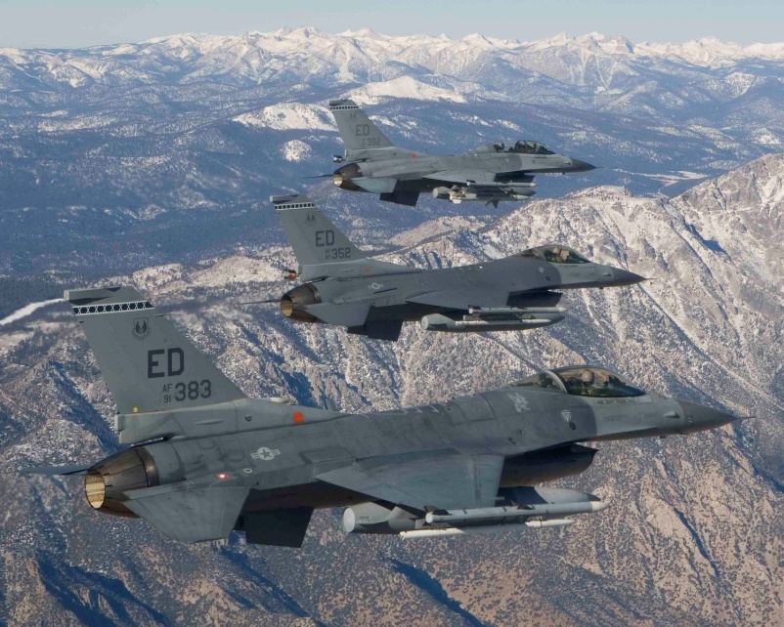
EWS cont…
Two types of EWS
Old version which is only compatible with the older model engine
New version which is compatible with both the older and newer engine models

Slide 10
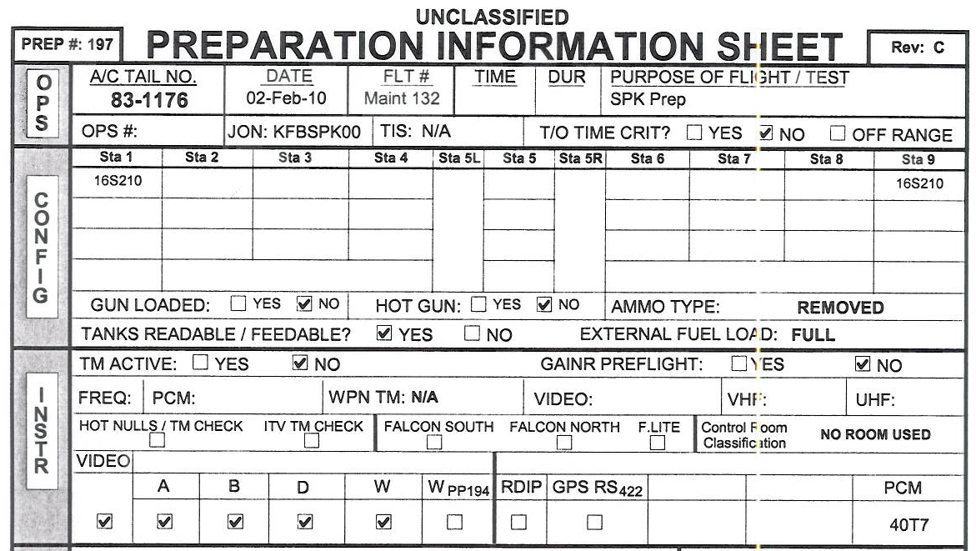
Configuration Control
The Prep Sheet
Key document in preparing the aircraft for test
Prepared by an experienced FTE who owns that aircraft
Sections include: OPS, CONFIG, INSTR, OFPs and REMARKS

Slide 11
Configuration Control…
REMARKS section is the backbone of the Prep Sheet
When modifying an aircraft, items in REMARKS may come from
Safety Package
Previous test programs
Knowledge from the aircraft’s FTE
Test team
Critical to have an experienced team to ensure the Prep sheet is an accurate relevant document

Slide 12
Findings cont…
So why did the EWS not get changed?
EWS part number was not verified because that action was not ordered on the prep sheet
A verification was not ordered on the prep sheet because the list of the aircraft’s Line Replaceable Units (LRU) incorrectly stated that the correct part number was installed
Why was the LRU part number listed incorrectly?
We don’t know for sure, but someone may have assumed the new EWS was installed because it was compatible with both engine models

Slide 13
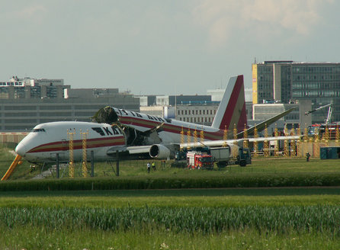
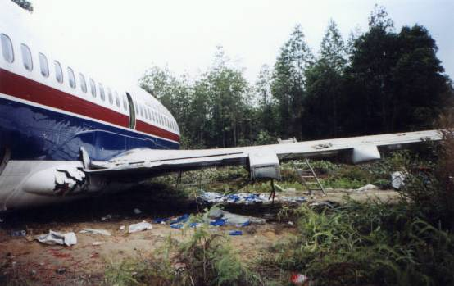
Rejected Takeoff
Higher risk maneuver which often ends with catastrophic consequences

Slide 14
Class A - Similar Incident
False avionics problem occurred at 120 KCAS
Decided to abort
Aircraft speed peaked at 168 KCAS
Heavyweight configuration
Missed the cable
Barrier was not raised at the end of the runway
Pilot ejected just prior to aircraft departing runway at 56 KCAS

Slide 15
Class A cont…
External fuel tanks ruptured, ignited and fuel was thrown onto the aircraft and the surrounding area
Pilot descended into the fire and became disoriented, and was entangled in the molten parachute around his legs, falling to the ground
Pilot died from his injuries 55 days after the mishap

Slide 16
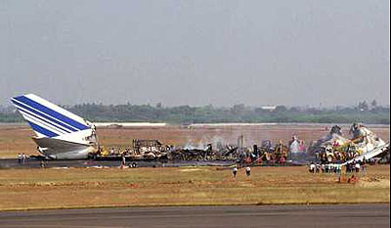
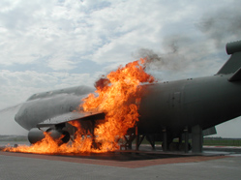
Hot Brakes
Even if you are able to stop on the runway, hot brakes are likely with a high potential for a brake fire
Maybe no injuries or fatalities, but loss or severe damage to test asset is likely

Slide 17
Configuration Problem #2
Maintenance investigation into Engine warning light revealed a Hardware / Software incompatibility of the Engine Control (EC) / Diagnostic Unit (DU) combination (non standard configuration)
Test team had consulted with Depot and contractor representatives to verify that the EC and DU were suitable for the test – told it was good to go
However, data analysis showed that engine diagnostic codes were not being properly reported, including cockpit warnings

Slide 18
Configuration Problem #3
Different aircraft involved in a High AOA test program
Maintenance paperwork review picked up an anomaly with the aircraft weight after a few missions
Subsequent investigation revealed a problem with the weight and balance information for the engine due to incorrect paperwork of the mod status
Shifted the CG slightly aft, which is in the direction of badness...(but we didn’t have to repeat the tests)

Slide 19
CTF Response
Three significant configuration problems discovered in the span of about 2 weeks
Commander’s Call for the entire CTF
Meeting of the Grey Beards with the following marching orders:
Identify any other potential configuration problems with CTF aircraft
Correct the current problems
Long term fixes to prevent future similar occurrences
However, fixes would need to be both internal and external to the CTF

Slide 20
Short Term Fixes
Changed EWS, updated paperwork on config and conducted high power engine run to test system
Low power run had been conducted for the engine install prior to first flight, but this obviously did not stress the system enough
New OFPs for the SMS and FCC to fix the data incompatibility between the EC and the DU
Verified mod status of engine via borescope, reweighed the test aircraft and fixed the paperwork
Physically verified critical LRUs in both squadron Frankenjet aircraft (and will post phase on the third)
Cross checked engine serial numbers at squadron with modification records and looked for discrepancies

Slide 21
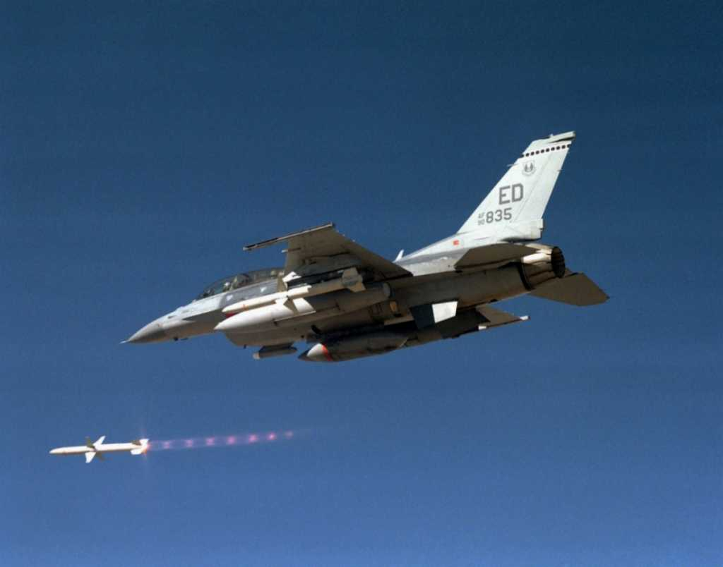
Long Term Fixes
Changes were made to squadron policy and procedures
After any test modification, critical LRUs must be physically verified
Acceptance of aircraft from depot / off station / non Test Wing organization, physical verification of critical LRUs must be performed

Slide 22
Long Term Fixes …
Incorporate appropriate build up approach to stress the non standard configuration
Only conducted low power run (schedule pressures?). High power run would have found the problem
How do we “stress the system” to build confidence?
Via meeting of the Grey Beards early in the program to determine test configuration, how that configuration will be implemented and how we can build confidence that the configuration will work

Slide 23
Long Term Fixes …
Stress the System
No guarantee it will catch all problems, but that is the inherent risk of test
Some stress tests are obvious – engine testing
Other programs may have a unique solution to stress the system
But they can all follow the same process to try and determine that stress
Currently building that process into squadron policy

Slide 24
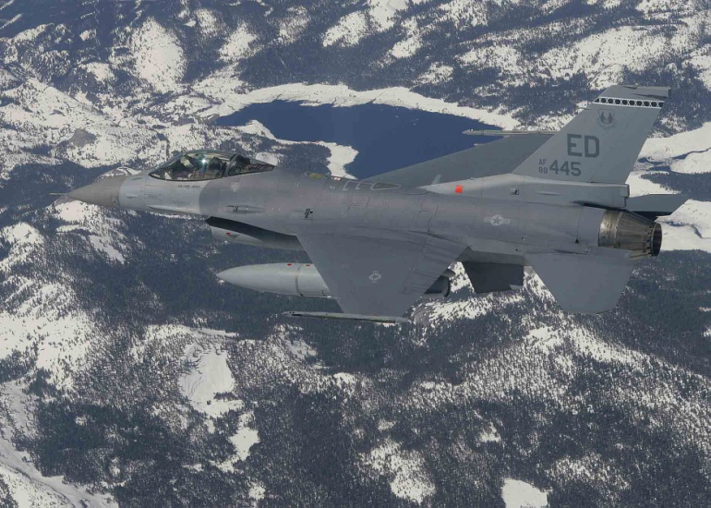
External challenges
First challenge: Incorrect mod status of engine was an external problem
How do you fix organizations outside your control that have a configuration control problem?
Can’t adopt the attitude of don’t trust outside agencies
Can’t just stick your nose in to some else's business
Need an SMS culture, where the focus is on improvement not blame

Slide 25
External challenges
Multi part solution
Be extra vigilant at the beginning until confidence is built that the problems have been corrected
Provide feedback to the non-flying organization so they appreciate the true impact of errors – they may not work up close and personal with the aircrew and aircraft
Make them part of the team to instill a sense of responsibility for the safety of the mission

Slide 26
External challenges
Second challenge: Contractor said items were compatible – they weren’t. Now what?
Again, inherent risk of test, you will sometimes miss certain outcomes
However smaller test programs have been moving away from onsite contractor involvement
Need to rebuild the team concept
Big difference between sending an email or talking over the phone when compared to being on site getting your hands dirty
Will increase that personal connection to the program which will naturally increase motivation to do a better job

Slide 27
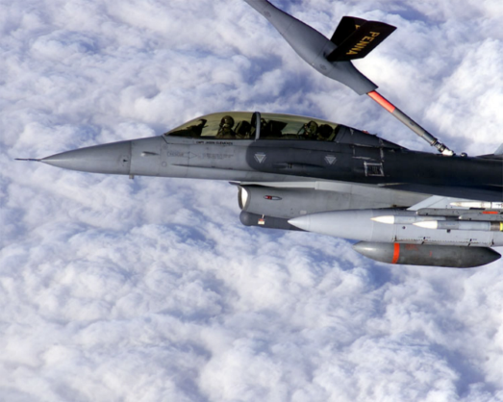
External challenges
However, increasing contractor involvement will raise costs
Program managers need to try and budget this type of support
Can still be very challenging to decide when to bring in that on site support grey beard support
But remember identifying problems early in a program will always save time and money in the long run

Slide 28
Outline
Project background
The close call
Findings
Risks during a High Speed aborted takeoff
Related Class A
More configuration problems discovered
CTF Corrective Actions
Conclusions

Slide 29
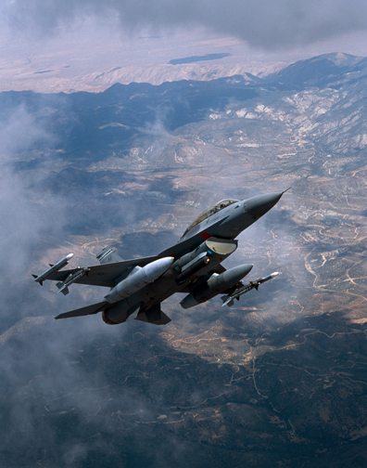
QUESTIONS?

