Slide 1




Royal Aeronautical Society
SETP/SFTE 4th European Flight Test Safety Workshop
Tuesday 28 – Wednesday 29 September 2010
Sponsored by: In Partnership with:

Slide 2

Safety Aspects of Light Aircraft
Spin Resistance Concept
Results of Research Project EASA.2008/03
Falk Pätzold, Thomas Rausch
SETP/SFTE 4th European Flight Test Safety Workshop, London, 29th September 2010
Notes:
Thank You!
At first I like to excuse for my English. As it is not my native language and I´m not well trained in using it, some words or expressions may not hit the point. So if some misunderstandings may occure please let me know.
As we have limited time we cannot handle any aspect of the topic. This presentation gives a brief overview about the results of a research project funded by the EASA.

Slide 3
Agenda
Background / Aims and Objectives
Methodology
Research results (summarised)
Outcomes
Recommendations
Summary
Notes:
The story can be told in different ways.
At first we will give you some background informations and will ..
In the third part my collegue Mr. Rausch will present you a summary of the research results.
In part 4 the results of part 3 will be combined to reason/justify the outcomes. The presentation will end with our recommendations and a brief summary.

Slide 4
1.a Background
14% of light aircraft fatal accidents are stall/spin related [53]
80% of stall/spin-related accidents starting below 1000ft above ground
Since 1991 (updated 1996), FAR23.221(a)(2) allows spin resistant designs
(amended stall behaviour, no demonstration of spin recoverability)
Two US Designs (Cirrus SR20/22, Cessna C350) are certified as spin resistant
CS23 does not contain the spin resistant option
EASA:
  Acceptance of FAA type certifications
  Need for harmonisation
  Funding of a research project on the topic
  Institute of Flight Guidance (Technische Universität Braunschweig)
  in cooperation with Messwerk GmbH and Leichtwerk AG

Slide 5
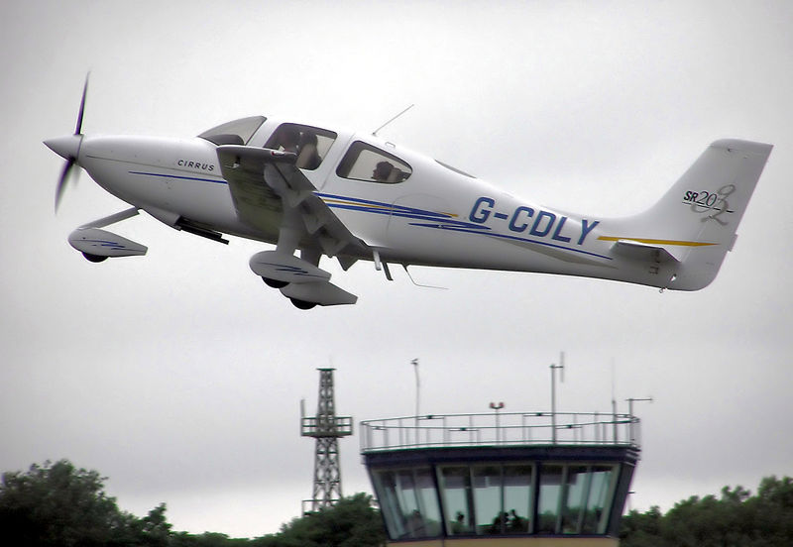

1.a Background
SR20
[13]
C350
[13]

Slide 6
1.b Aims and Objectives
Primary objective of the project is to investigate safety criteria which will form the fundamental basis for proposing an amendment to CS23.221
Proposal: Code section and Flight Test Guide (FTG)
Increase awareness within European industry
Modality:
General / fundamental view, not restricted to certain principles
No research on new technical measures
Scope: Necessities to ensure safety
Notes:
The focus of the project was on the necessities to ensure a certain level of safety and not on the abilities of certain technologies.

Slide 7
2. Methodology
Literature review
Analysis of accident statistics and reports
Questionnaire
Interview with experts
  Based on interim findings in 1.-4.:
Flight trials
  Based on findings 1.-5.:
Proposal for a code section and Flight Test Guide (FTG)

Slide 8
Agenda
Background / Aims and Objectives
Methodology
Research results (summarised)
  Literature review
  Analysis of accident statistics and reports
  Questionnaire
  Interviews with experts
  Flight trials
Outcomes
Recommendations
Summary

Slide 9
3.1 Literature review
1. Overview on NASA research on spin resistance
- configurations
→ e.g. Canard
- stall deterrent system
→ effective, but adverse cost + weight (at that time)
- wing modifications
→ flight testing and development of regulation
Notes:
Significant research on the topic of SPR has been done by NASA during the 70ies and 80ies
At first, research in various directions
Further research concentrated on wing mod
Aimed that regulation comes into widespread use for 1. reduce accidents
2. reduce expense of certification flight testing

Slide 10
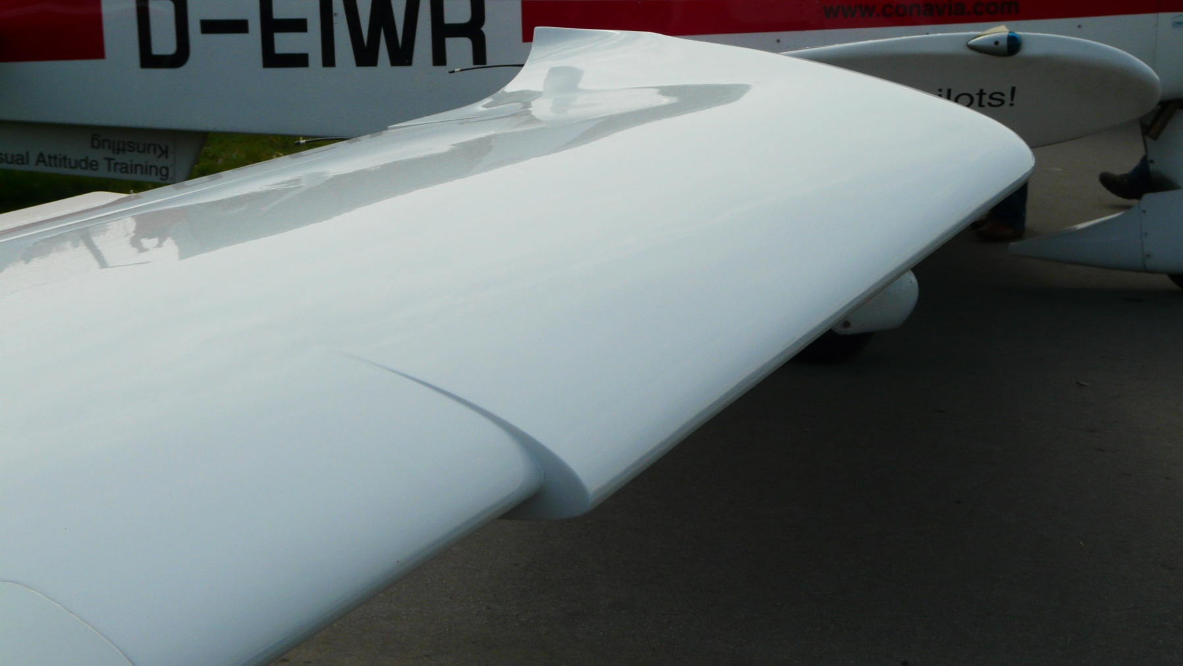
3.1 Literature review – wing modifications
Modified outboard leading edge (MOLE)
[13]

Slide 11
3.1 Literature review – wing modifications
MOLEs: enhanced lateral controllability at stall,
aircraft less likely to enter a spin
Aircraft behaviour highly dependent on flight state / control inputs
  → Aircraft still can enter spirals and spins
  (high speed rate / maximum power setting)
FAR23.221(a)(2) :
representative manoeuvres oriented on abilities of MOLEs

Slide 12
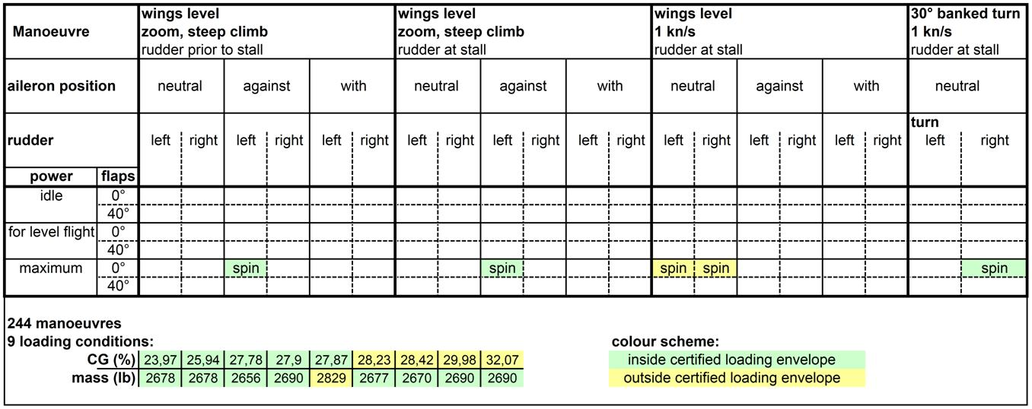
3.1 Literature review – wing modifications
Flight test matrix PA28

Slide 13
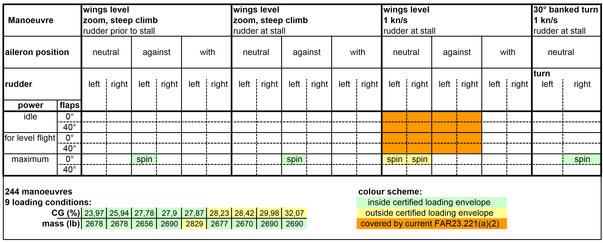
3.1 Literature review – wing modifications
Flight test matrix PA28

Slide 14
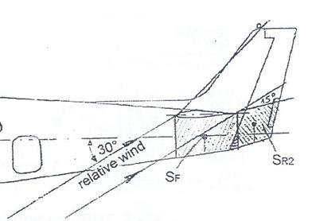
3.2 Literature review
2. Recoverability
Principles for design of suitable empennage are well-known
        [48]
3. History, general view on stall/spin behaviour etc.
Notes:
Other aspects of the literature research have been..

Slide 15
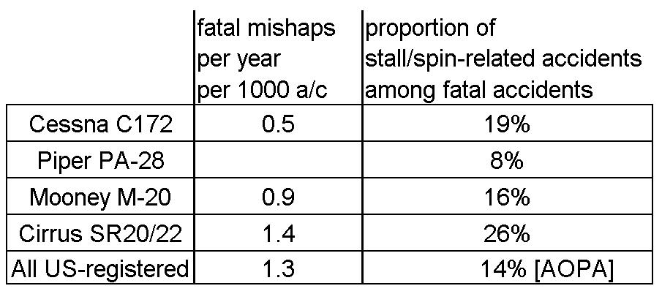
3.2 Analysis of accident statistics and reports
Comparison of accident statistics
(Spin-resistant aircraft vs. other aircraft)
Amount of stall/spin-related accidents not reduced
Most of these accidents still starting from low altitudes
[NTSB statistics 2007/08,
published by Cirrus aircraft
+
NTSB-reports, fatal
accidents 1999-2008]

Slide 16
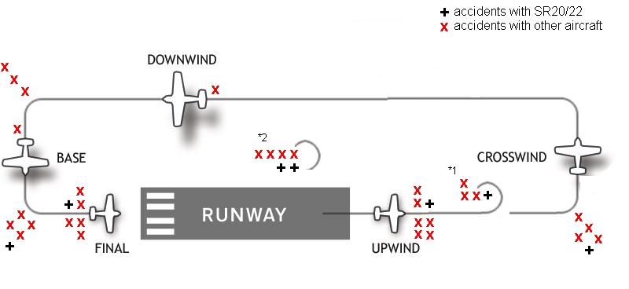
Position of occurrences within traffic pattern
3.2 Analysis of accident statistics and reports
based on [17]
Accident reports:
No principal difference in sequence of events
Hints on: - high / suddenly induced bank angles
- unusually steep pull up

Slide 17
3.3 Questionnaire
Aim:Take account of the experience and needs of European GA manufacturers
  (additionally sent to national authorities and further recipients)
  Containing questions on:
  General considerations on stall and spin
  Concept of spin resistance
  Future concepts
  Further / general comments
Some of the results / statements
Artificial stall barriers and warnings should also be considered
Both sympathy and rejection towards the concept of spin resistance
Main aspect of criticism: lack of dynamic entry manoeuvres
Situational awareness → training + warnings

Slide 18
3.4 Interviews with experts
  Hans-Ludwig Meyer
  Gerhard Stich
  Uli Schell
  Heiner Neumann
  Hans-Jürgen Berns
  Dietmar Schmerwitz
  Concluding statements
Operational accident situations not covered by current FAR 23.221(a)(2)
Improved stall warnings + envelope protection recommended instead of passive flight mechanical measures
Combination with concepts for training instead of solely technical measures

Slide 19
3.5 Flight trials
FAR23.221(a)(2): Limited set of manoeuvres intended as “representative of operational situations“
Aim of flight trials: Effect of parameter variations on stall charateristics
using representative manoeuvres
Starting points:
Current FAR23.221(a)(2)
EASA proposal (EASA-V5)
Additional manoeuvres and parameter variations
8 types of manoeuvres
Cessna F 172N

Slide 20
3.5 Flight trials
Manoeuvre type C (exemplary)
Source:
EASA-V5 23.221(b)(4)
Content:
Reduce speed until stick aft, 7s full rudder, ailerons
deflected opposite “attempting to maintain heading”
- Immediate respond to flight controls?
- Reversal of control effect?
- Temporary control forces above limit?
- State of flight achieved before recovery?
Parameters to be varied
acc. EASA-V5
power setting
wing flaps
Parameters to be varied
additionally
speed rate
aileron deflection
additional power settings
For other manoeuvres see study report

Slide 21
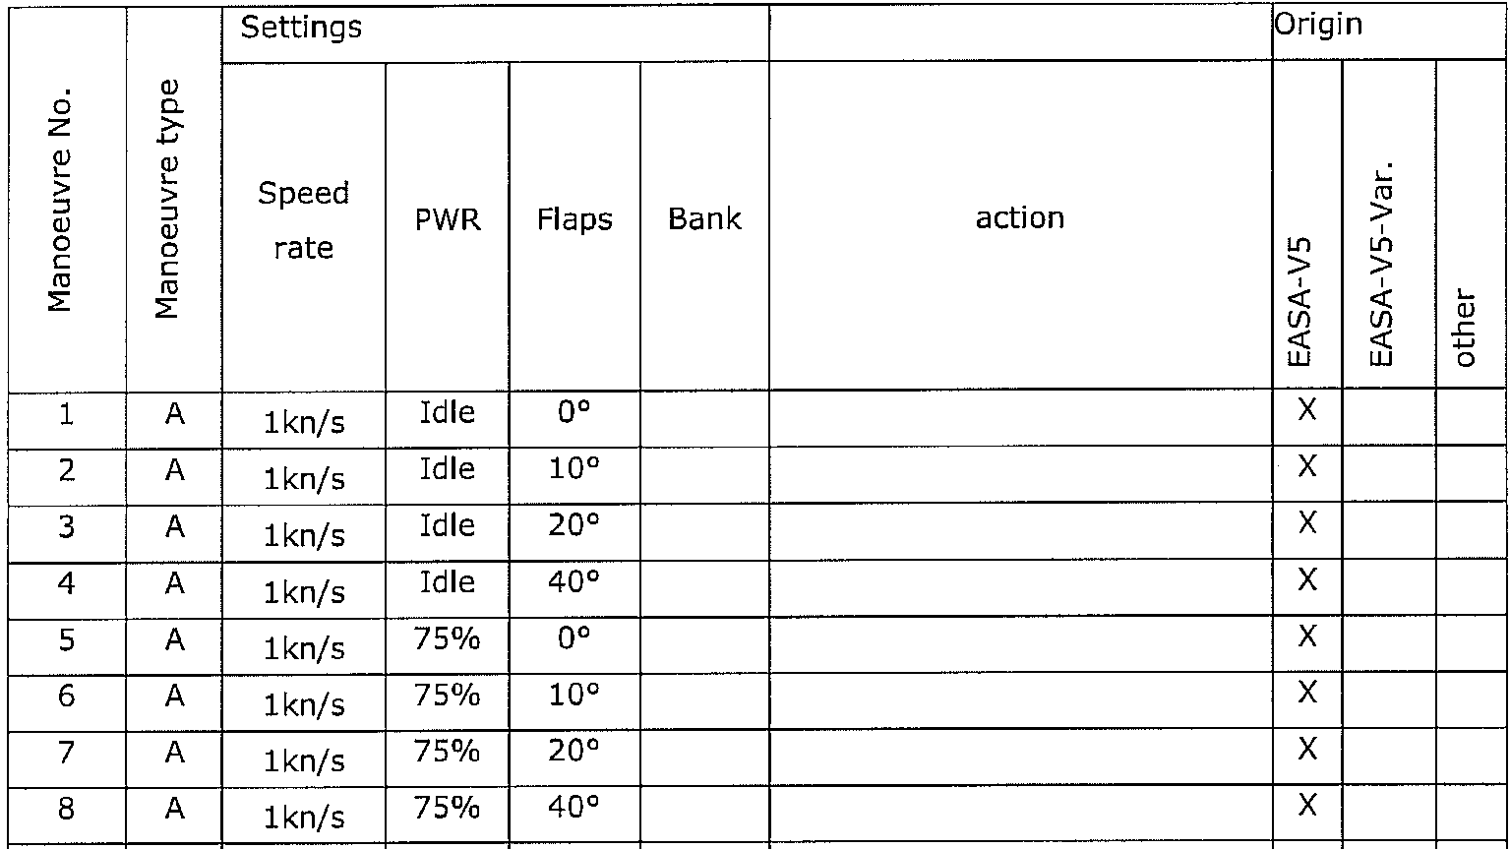
3.5 Flight trials
Manoeuvres according Type A (exemplary)
115 (199, several left and right) manoeuvres
For complete list of manoeuvres see study report section 13.7

Slide 22
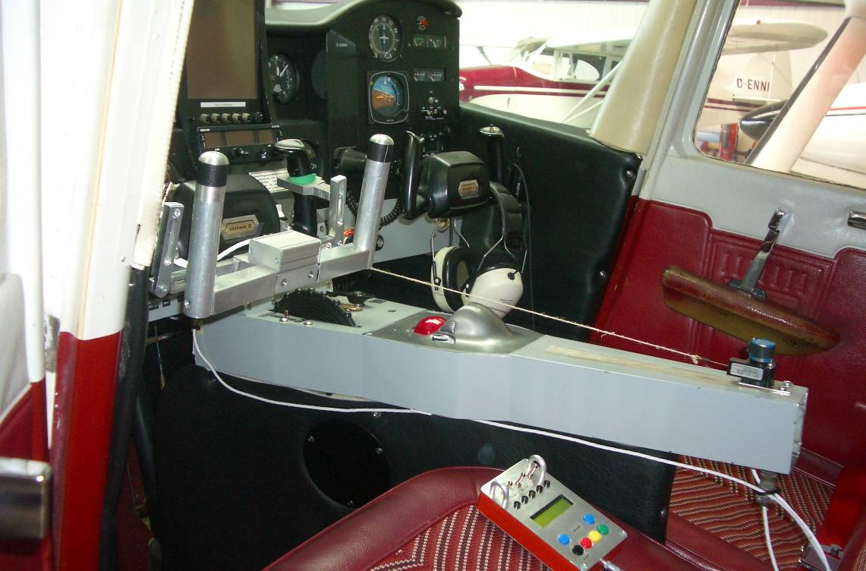
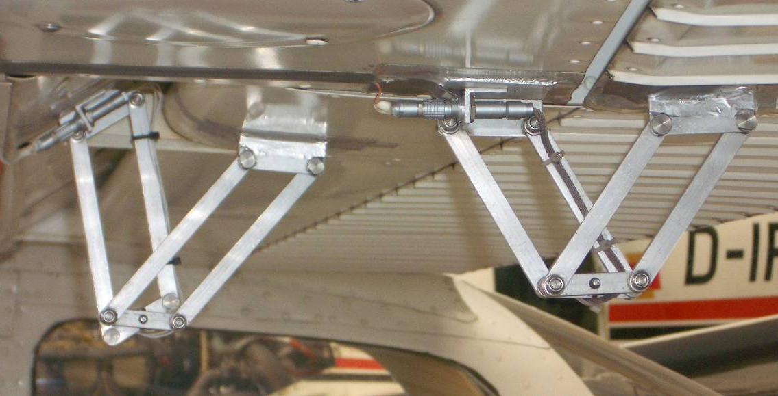
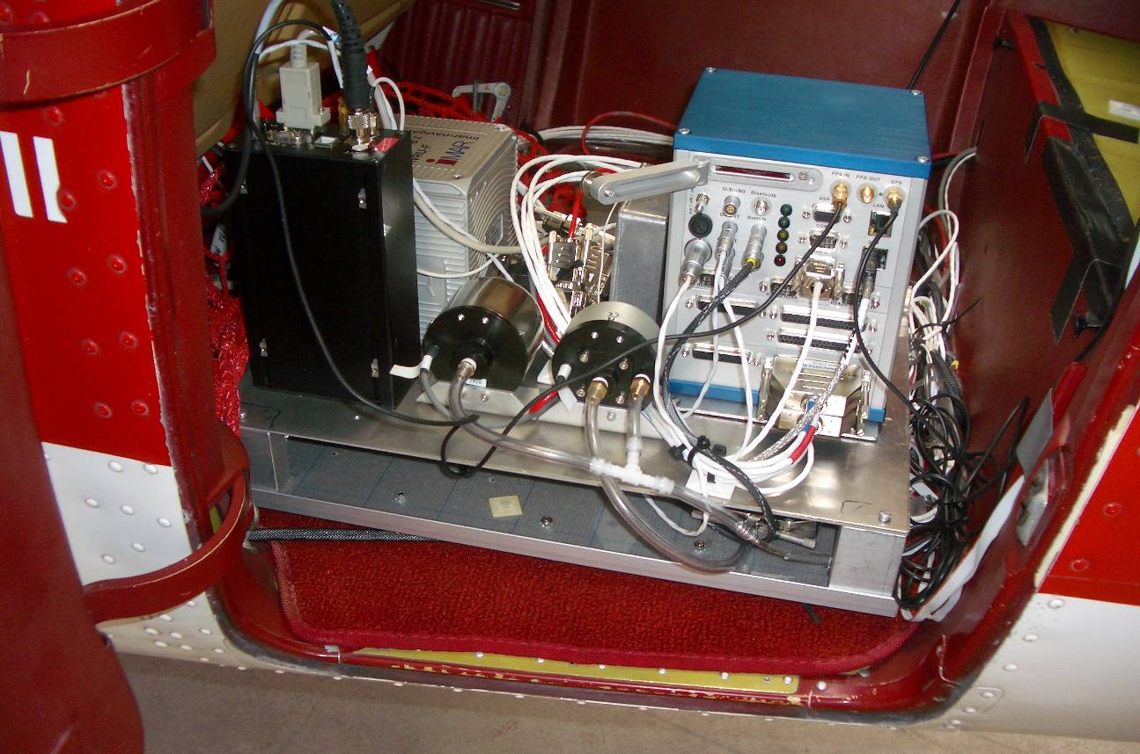
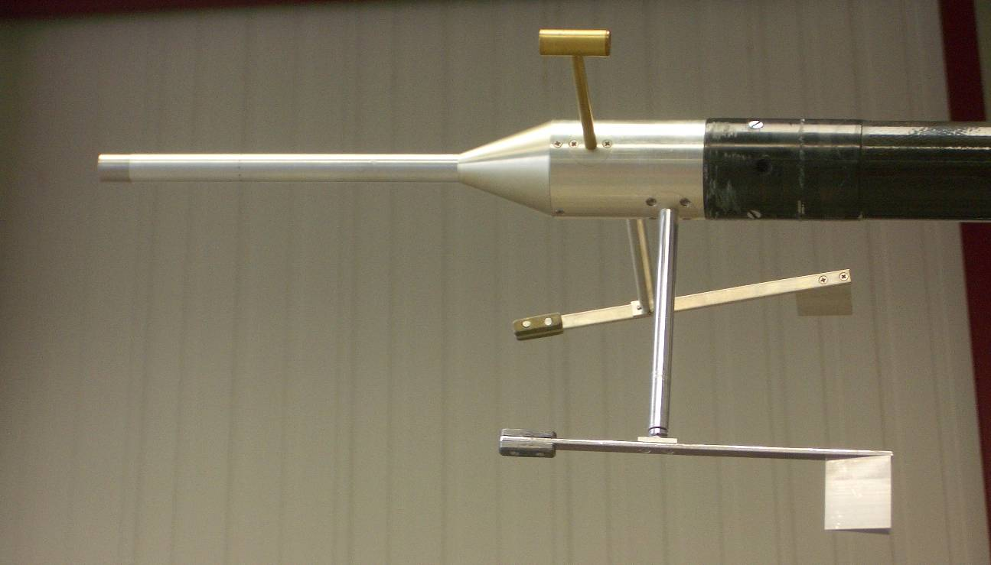
3.5 Flight trials – measurement system
Aileron and flap deflection sensors (left wing)
Stick force sensor, power lever sensor
Air data probes (wing boom)
GPS receiver, pressure sensors, inertial measurement unit, data aquisition

Slide 23
3.5 Flight trials - Results
Exemplary plot of one manoeuvre →
→ Extraction of relevant results from measured data and handwritten crew perceptions to a data base.

Slide 24
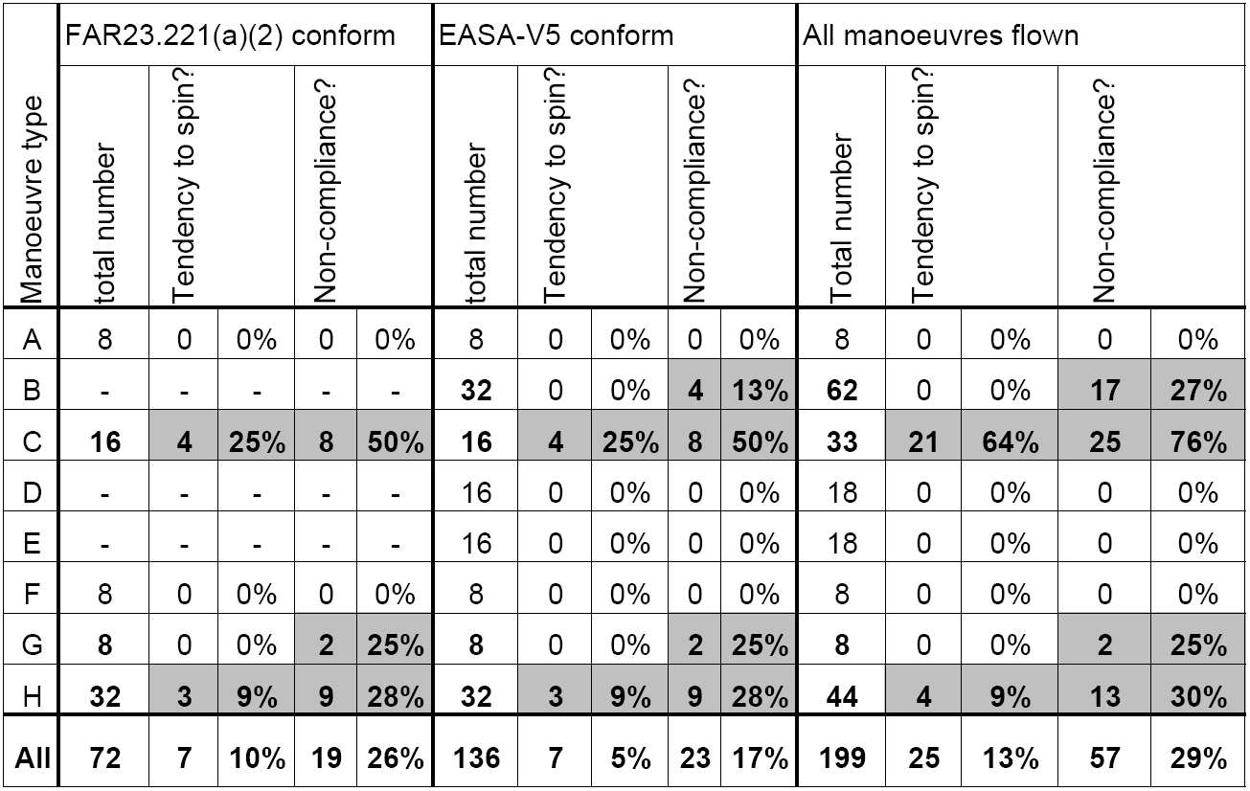
3.5 Flight trials - Results
No non-compliances
→ Statistical analysis
Non-compliances but no tendencies to spin
Every addition resulted in a
non-compliance
30° bank stall,
non-compliance linked to excessive height loss

Slide 25
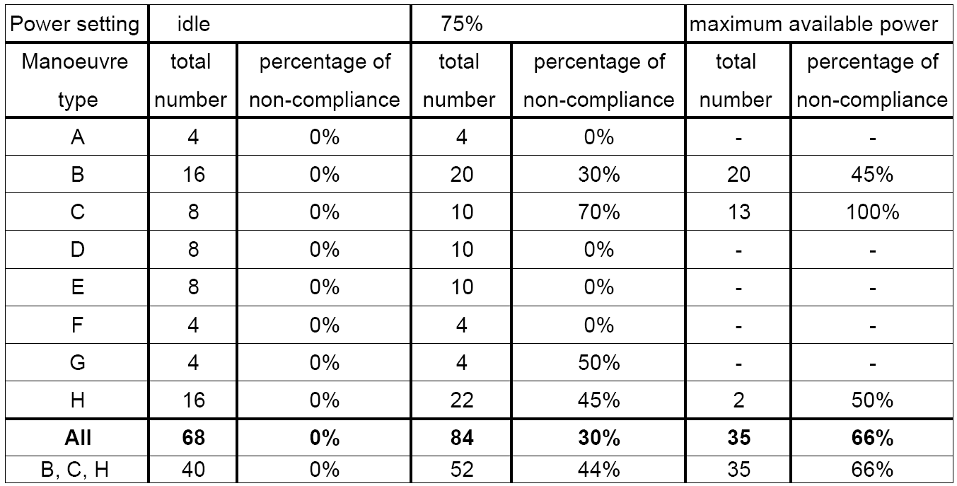
3.5 Flight trials - Results
Non-compliances and power setting (all manoeuvres)
Number of non-compliances increases with increasing engine power

Slide 26
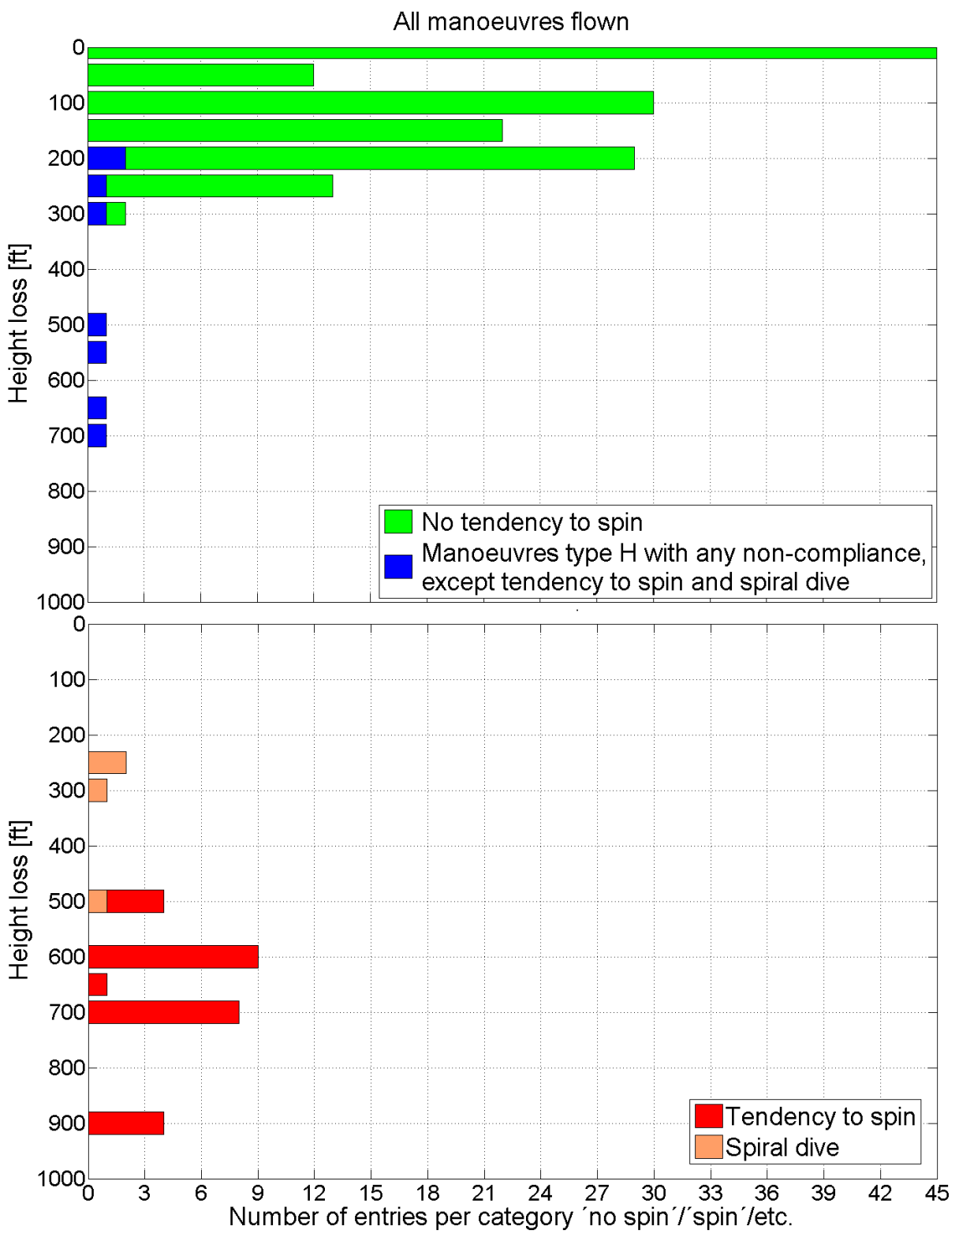
3.5 Flight trials - Results
Height loss for recovery
Note: Flight trials were not performed to demonstrate minimum height loss.

Slide 27
Agenda
Background/Aims and Objectives
Methodology
Research results (summarised)
Outcomes
Recommendations
Summary

Slide 28
4.a Outcomes - General point of view
80% of stall/spin-related fatal accidents start below 1000ft above ground
To improve: A combination of possible measures is most beneficial
1) Stall characteristics
2) Improved stall warning
3) Envelope protection
4) Training
→ Evaluation of current FAR23.221(a)(2)
  Literature review
  Questionnaire
  Interview with experts
  Accident analysis
  Flight trials
Not in the scope of this study

Slide 29
4.b Outcomes - Evaluation of current FAR23.221(a)(2)
FAR23.221(a)(2) is based on available literature about spin resistant concept
Experts see limited potential in spin resistance concept
Questionnaire: Ambiguous response
→ Evaluation of current FAR23.221(a)(2) based on executed …
  … Analysis of accident statistics and reports
  … Flight trials
Does the limited set of manoeuvres according current FAR23.221(a)(2)
represent most or all accident-prone operational situations?

Slide 30
4.b Outcomes - Evaluation of current FAR23.221(a)(2)
Flight trials:
C172 does not comply with FAR23.221(a)(2)
FAA type certification:
Cirrus SR20/22 complies with FAR23.221(a)(2)
FAR23.221(a)(2) non-compliances:
Only at 75% MCP²
According FAR23.221(a)(2):
75% MCP²
1kn/s speed rate
Emphasis of non-compliances
(all manoeuvres):
100% MAP³ + 3..5kn/s speed rate
Analysis of accident statistics and reports:
0.5 fatal mishaps/year/1000 A/C
19% stall/spin related
1.4 fatal mishaps/year/1000 A/C
26% stall/spin related
Significant changes of stall characteristics due to additional parameters
Stall/spin related C172 accidents linked to high power setting
In operational accidents, pilots presumably applied parameters not contained in
current FAR23.221(a)(2)
² MCP - Maximum continuous power
³ MAP - Maximum available power

Slide 31
Analysis of accident statistics and reports
- Position of occurrences within traffic pattern
4.b Outcomes - Evaluation of current FAR23.221(a)(2)
based on [17]
Accidents in descend and climb, turn and „straight“ sections
Banked turns, maximum available power and speed rates more than 1kn/s are decisive operational situation

Slide 32
4.b Outcomes - Evaluation of current FAR23.221(a)(2)
Rate of stall/spin-related accidents among fatal accidents not reduced
by existing spin resistance designs
No differences in position of accidents within traffic pattern
In operational accidents, pilots presumably applied inputs not contained
in current FAR23.221(a)(2)
Current FAR23.221(a)(2) spin resistance requirement does not cover
        decisive operational accident situations
Experts: “Operational accident situations not covered by current requirement“
Questionnaire: “Main aspect of criticism: lack of dynamic entry manoeuvres”
Literature review on spin resistance: NASA‘s dynamic entry manoeuvres not contained

Slide 33
4.c Outcomes – Proposed requirement
Proposal for new requirement contains additions
Maximum available power
Higher rate of speed reduction
Banked turns with pro spin inputs
Limitation of height loss for recovery
Improve pilots awareness

Slide 34
4.c Outcomes – Proposed requirement
1. Demonstration of manoeuvres with maximum available power additionally
  Accidents during ascending parts of traffic pattern
        (→ Analysis of accident reports)
  Maximum available power may also be applied in descending part
  Stall behaviour of aircraft highly dependent on power setting
        (→ NASA; Flight trials within this project)
  Density proportional decrease of maximum available power
  (→ non-charged piston engine: 70% at FL100)

Slide 35
4.c Outcomes – Proposed requirement
2. Higher rate of speed reduction
  Stall behaviour of aircraft highly dependent on speed rate
        (→ NASA; Flight trials within this project; Experts)
  Abrupt control inputs and pull-ups during operational accidents
        (→ Accident reports; Experts)
3. Banked turns with pro-spin control inputs
  Accidents starting during turns
    (→ Analysis of accident repots; Experts)
  Stall behaviour can be different
  (→ NASA; Flight trials within this project; Experts)

Slide 36
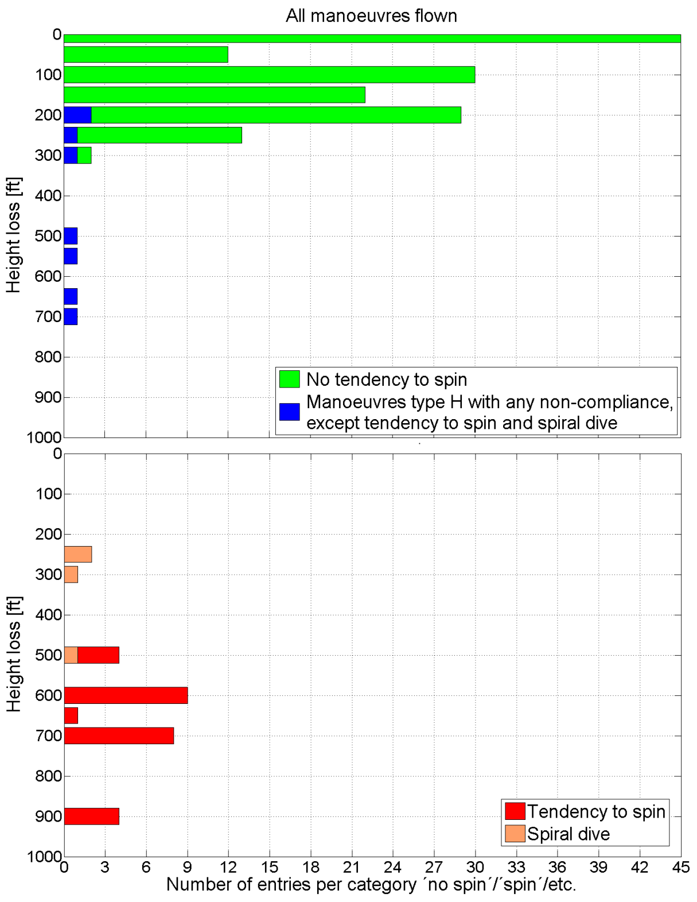
4.c Outcomes – Proposed requirement
4. Limitation of height loss for recovery
Impact to the ground in a stalled
flight state often ends up fatally, no
matter if a spin was entered or not.
Proposed maximum height loss: 300ft
- 1/3 of usual traffic pattern height
- Turn into final approach finished at
this height according guidelines
Note: Flight trials were not performed to
demonstrate minimum height loss.

Slide 37
4.c Outcomes – Proposed requirement
5. Improve pilots‘ awareness
  → Here: Placard on instrument panel
  Risk to enter a not recoverable flight state
  Too many pilots are not aware of conceptual differences
  Placard must differ from conventional aircraft
AVOID STALL! DO NOT SPIN!
Spin recovery is not demonstrated

Slide 38
4.d Outcomes – What is Spin Resistance?
Maximum available power
Higher rate of speed reduction
Banked turns with pro spin inputs
Limitation of height loss for recovery
Improve pilots awareness
The term ‘spin resistance’ describes the ability of an aircraft, due to design, to counter entry into the flight state of spinning or other stall-related flight states resulting in unfavourable height loss and long recovery time.
Its aim is to prevent the pilot substantially from entering a stalled flight state that cannot be recovered within certain limits (altitude, time).

Slide 39
5. Recommendations
Implementation of the proposed code section
Further investigation of:
  Training methods / methods to promote pilots‘ situational awareness
  Enhanced stall warning systems
  Stall barrier systems / envelope protection
6. Summary
Review on spin resistance
  Aircraft behaviour
  Pilot behaviour
  Operational experience
Considerations from a general point of view
Evaluation of the current FAR23.221(a)(2)
Derivation of a proposal for a requirement

Slide 40
Royal Aeronautical Society
SETP/SFTE 4th European Flight Test Safety Workshop
Tuesday 28 – Wednesday 29 September 2010
Sponsored by: In Partnership with:

